Slide 1
Basic Electronics
Diode Circuits
Clipper and Clamper

Slide 2
Clipper
clipper is a device designed to prevent the output of a circuit from exceeding a predetermined voltage level without distorting the remaining part of the applied waveform.

Slide 3
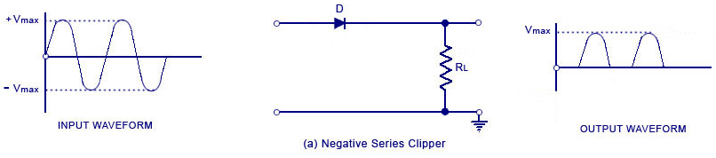
Series Negative Clipper
The negative clipping circuit is one where the diode is connected with reversed polarity, the cir­cuits will become for a negative series clipper.

Slide 4
In a negative clipper, the negative half cycles of the input voltage will be removed. The circuit arrangements for a negative clipper are illustrated in the figure above.
As shown in the figure, the diode is kept in series with the load. During the negative half cycle of the input waveform, the diode ‘D’ is reverse biased, which maintains the output voltage at 0 Volts. Thus causes the negative half cycle to be clipped off. Dur­ing the positive half cycle of the input, the diode is forward biased and so the positive half cycle appears across the output.
Consequently the entire input voltage appears across the diode or across the load resistance R_{L} if R is much smaller than R_{L.}

Slide 5
SERIES-NEGATIVE CLIPPER WITH BIAS:
Fig shows the circuit of a biased series negative diver. In this circuit clipping take place during the negative half cycle only when the input voltage V_{i} > V_{B} .The clipping level can be shifted up or down by varying the bias voltage ( -V_{B})

Slide 6
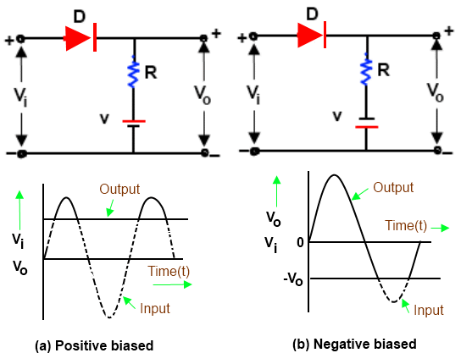

Slide 7
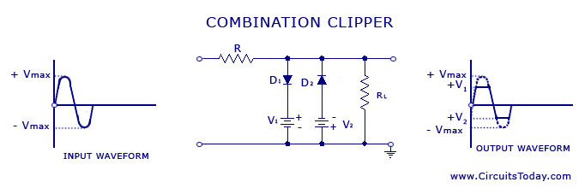
Two Way Parallel clipper

Slide 8
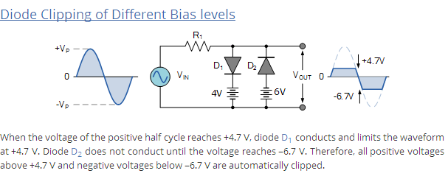
Problem on combinational Clipper:

Slide 9
Clippers:
Q1. Draw the circuit of series negative clipper and explain its operation
along with waveform. [University exam Dec. 2013]
Q2. Explain series Positive clipper in detail with suitable waveforms.
Q3. Explain Parallel negative clipper in detail with suitable waveforms.
Q4. Explain Parallel Positive clipper in detail with suitable waveforms.
Q5. Two way parallel Clipper with suitable waveforms.

Slide 10
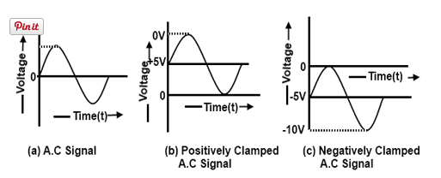
Clampers:

Slide 11
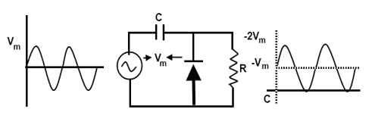
Positive Clamper:
V0=Vm-------------for Vin=0
V0=2Vm for Vin=Vm
V0=0 for Vin=-Vm

Slide 12
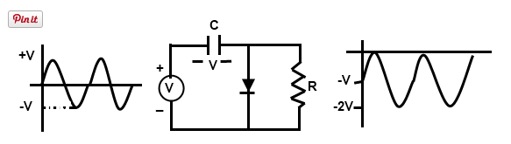
Negative Clamper:
V0=-Vm-------------for Vin=0
V0=0 for Vin=Vm
V0=-2Vm for Vin=-Vm

Slide 13
Clampers
Clampers:
Q1. Explain working of Positive clamper with
neat circuit diagram.
Q2. Explain working of Negative clamper with
neat circuit diagram.

